Slide 1
Random Numbers
CSI 423: Simulation and Modelling

Slide 2
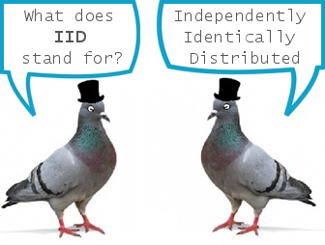
The goal
Stochastic simulations need to generate IID (Independent and identically distributed ) random numbers
Inter Arrival Times
Service times
Specially we need U(0,1)

Slide 3
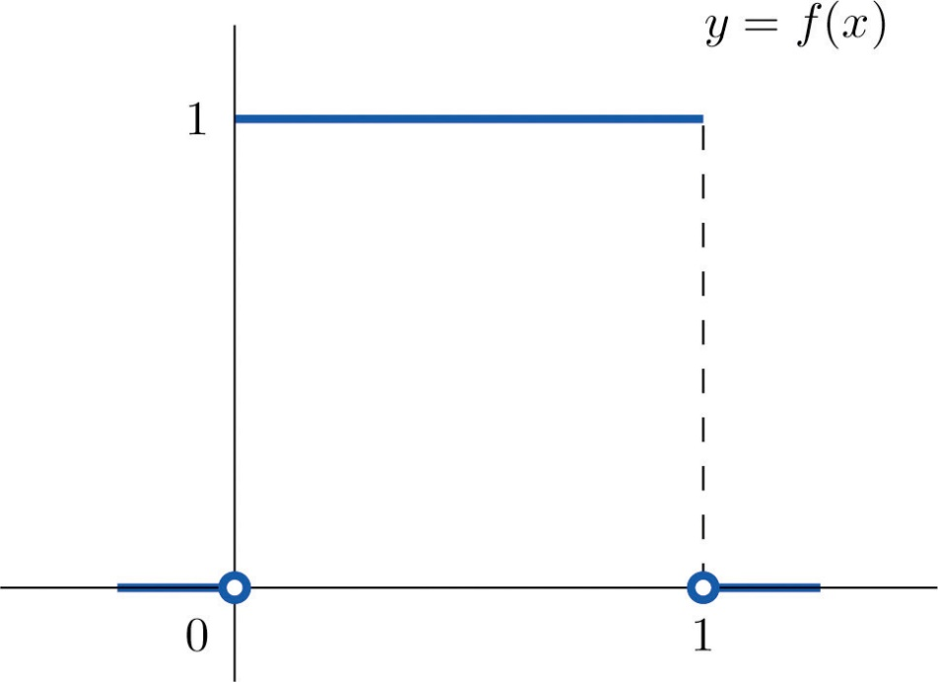

U(0,1)

Slide 4
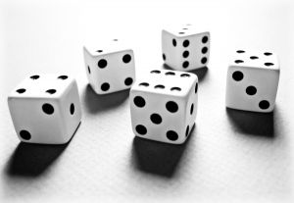
Early Methods
Physical
Cast lots
Dice
Cards
Urns
Lotteries
Mechanical
Spinning disks
Electrical
ERNIE
RAND
Others
Pick digits “randomly” from Scottish phone directory or census reports
Decimals in expansion of π to 100,000 places

Slide 5
Algorithmic Methods
Sequential
the next “random” number is determined by one or several of its predecessors according to a fixed mathematical formula
Midsquare Method
von Neumann and Metropolis, 1945
Start with a 4 digit number
Square it and take middle 4 digits and put a decimal before the number

Slide 6
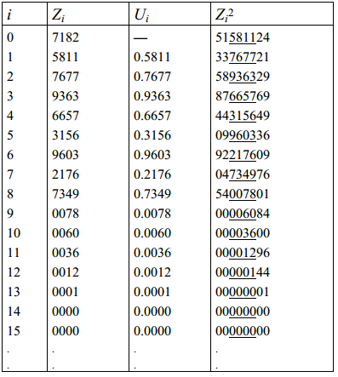
Midsquare Method

Slide 7
Midsquare Method
Disadvantages
Not really “random”—entire sequence determined by the seed Z
If a Z_{i} ever reappears, the entire sequence will be recycled
We need long cycles

Slide 8
Can We Generate “Truly” Random Numbers?
Only possible with physical experiment having output ~ U(0,1)
Still some interest in this (counting gamma rays from space)
Not reproducible
Impractical for computers (wire in special circuits)
Practical view: produce stream of numbers that appear to be IID

Slide 9
Criteria for RNG
Appear to be distributed uniformly on [0,1] and independent
Fast, low memory
Be able to reproduce- why?
Makes debugging easier
Comparison
Provision for separate streams

Slide 10
Linear Congruential Generators (LCG)
Lehmer, 1954
Specify four parameters
Z₀ = seed
m = modulus
a = multiplier
c = increment
Z_{i}=(aZ_{i-1}+c)(mod m)
U_{i} = Z_{i} / m

Slide 11
Linear Congruential Generators (LCG)
Problems
Not really random
Cycles
They can take discrete values

Slide 12
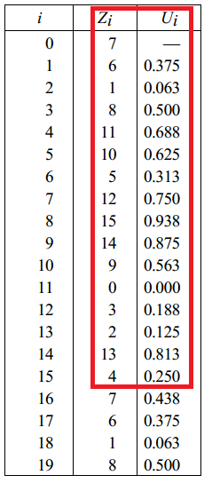
Example
m=16, a=5, c=3, z₀=7
Cycle length = 16
Its maximum – full period

Slide 13
Full Period Theorem
Hull and Dobell, 1966
The LCG Z_{i}=(aZ_{i-1}+c)(mod m) has full period if and only if all three of the following hold
c and m are relatively prime
If q is any prime number that divides m, then q also divides a-1
If 4 divides m, then 4 also divides a-1

Slide 14
Other properties
Fast
Low storage
Reproducible
Restart in the middle
Multiple streams
Portability Issue:
Might cause integer overflow

Slide 15
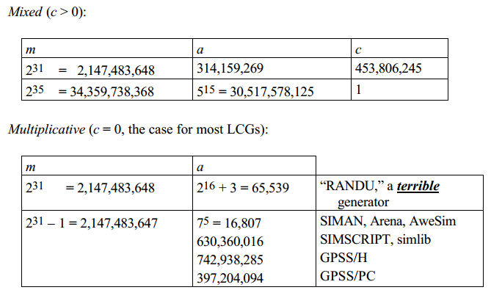
Some LCGs

Slide 16
General Congruences
LCGs are special case of the form Z_{i}=g(Z_{i-1},Z_{i-2},…), U_{i}=Z_{i}/m
g(Z_{i-1})=aZ_{i-1}+c (LCG)
g(Z_{i-1}, Z_{i-2}, …, Z_{i-q})= a₁Z_{i-1} + a₂Z_{i-2} + …+ a_{q}Z_{i-q} (multiple recursive generator)
g(Z_{i-1})=a`Z_{i-1}²+ aZ_{i-1}+ c (quadratic)
g(Z_{i-1}, Z_{i-1})= Z_{i-1}+Z_{i-2} (fibonacci - bad)

Slide 17
Composite Generators
Shuffling
Fill a vector of length 128 (say) from generator 1
Use generator 2 to pick one of the 128 in the vector
Fill the hole with the next value from generator 1, use generator 2 to pick one of the 128 in the vector, etc.
shuffling a bad generator improves it, but shuffling a good generator doesn’t gain much.

Slide 18
Composite Generators
Differencing LCGs
Let Z_{1i} and Z_{2i} from different LCGs with different moduli
Let Z_{i}=(Z_{1i}-Z_{2i})(mod m); U_{i}=Z_{i}/m
Very long period
Good statistical properties
portable

Slide 19
Composite Generators
Wichman/Hill
Use three LCGs to get U_{1i},U_{2i} and U_{3i}
Let U_{i}= sum of fractional part of U_{1i},U_{2i} and U_{3i}
Good period
But equivalent to LCGs

Slide 20
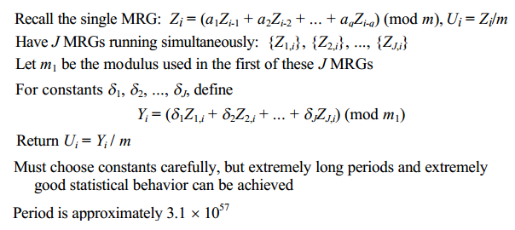
Combined Multiple Recursive Generators

Slide 21

Tausworthe
Originated in cryptography
Generate sequence of bits b₁, b₂, b₃, ... via congruence
Various algorithms to group bits into U_{i}’s
Can achieve very long periods

Slide 22
Unpredictable Generators
Blum/Blum/Shub
Another way to generate a sequence of bits
Pick p and q to be large (like 40-digit) prime numbers, set m = pq
X_{i}=X_{i-1}² (mod m)
b_{i} = parity of X_{i} (0 if even, 1 if odd)
P=11, q=19 seed=3

Slide 23

Testing Random Numbers
Chi Square test

Slide 24
Chi Square (χ²) Test
We test if the observed data fits any distribution using Chi Square Statistic
Carl Pearson, 1900

Slide 25
Example
Suppose a restaurant manager is making the following claim about number of customers
We have to test whether he is saying truth or not
Day | Sat | Sun | Mon | Tue | Wed | Thu
# of Customers | 10% | 10% | 15% | 20% | 30% | 15%

Slide 26
Null Hypothesis
H₀= Owner’s hypothesis is correct
Alternate hypothesis: H₁ = Owner’s hypothesis is not correct
Suppose we observe the following data:
Day | Sat | Sun | Mon | Tue | Wed | Thu | Total
# of Customers | 30 | 14 | 34 | 45 | 57 | 20 | 200
Expected | 20 | 20 | 30 | 40 | 60 | 30

Slide 27
X² calculation
X²= (30-20)²/20+ (14-20)²/20+ (34-30)²/30+ (45-40)²/40+ (57-60)²/60+ (40-30)²/30 = 11.44
Now we have to test what is the probability to get this value?
Degrees of freedom = 6-1=5

Slide 28
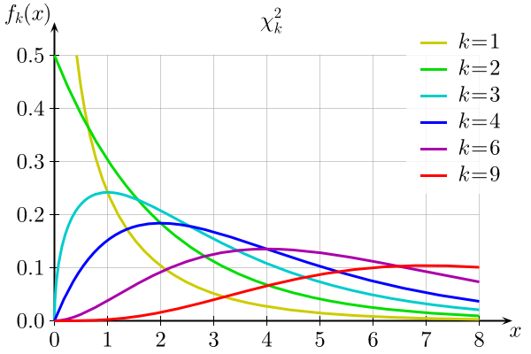
Chi Square (χ²) Test

Slide 29
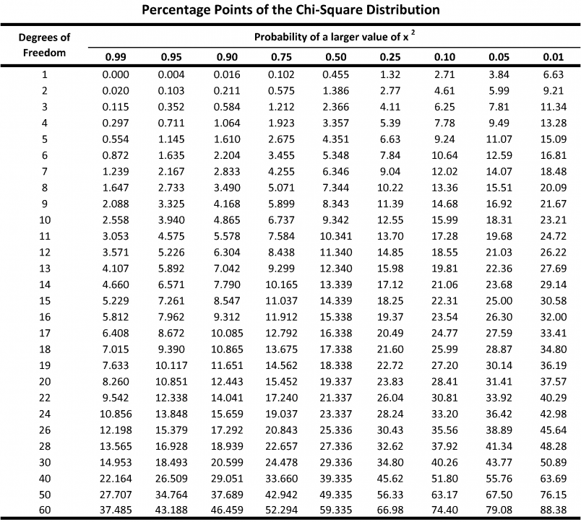
Chi Square (χ²) Test

Slide 30
Kolmogorov Smirnov Test
KS tests the hypothesis that a given unknown distribution Ψ is equal to another distribution, Θ
Null Hypothesis, H₀:Ψ= Θ
Alternate hypothesis, H₁: Ψ≠ Θ

Slide 31
KS Test Example
Suppose we observe 8 data points
1.41 0.26 1.97 0.33 0.55 0.77 1.46 1.18
Is there any evidence to suggest that the data were not randomly sampled from a Uniform(0, 2) distribution?

Slide 32
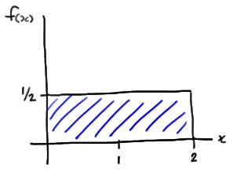
U(0,2)

Slide 33
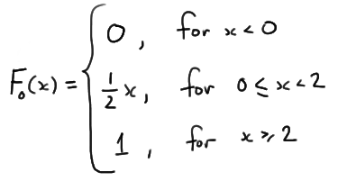
U(0,2)

Slide 34
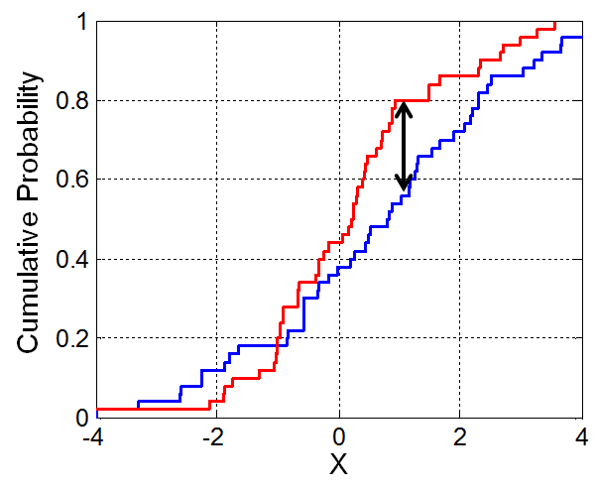
KS Test

Slide 35
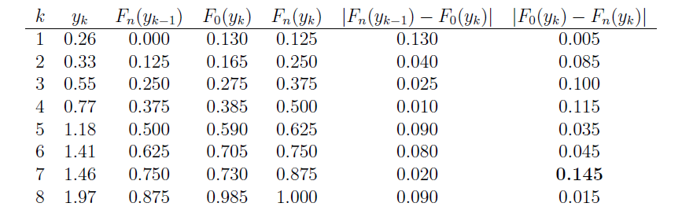
KS Test

Slide 36
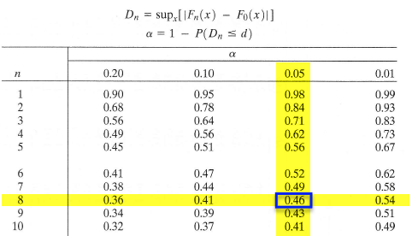
KS Test

Slide 37

Variates
observations (“variates”) from some desired input distribution (exponential, gamma, etc.)
Inverse Transform
Composition
Convolution
Acceptance-Rejection
Special Properties

Slide 38
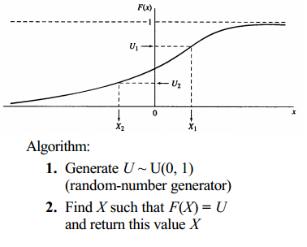
Inverse Transform (continuous)

Slide 39
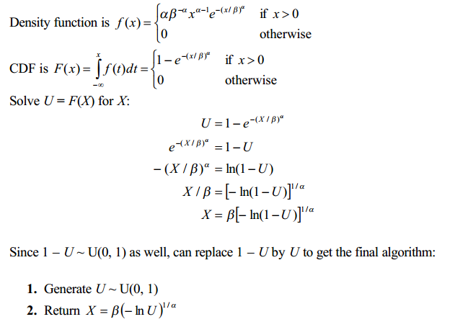
Weibull Distribution

Slide 40
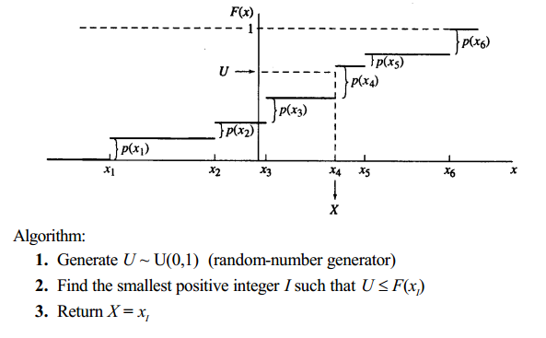
Inverse Transform (Discrete)

Slide 41
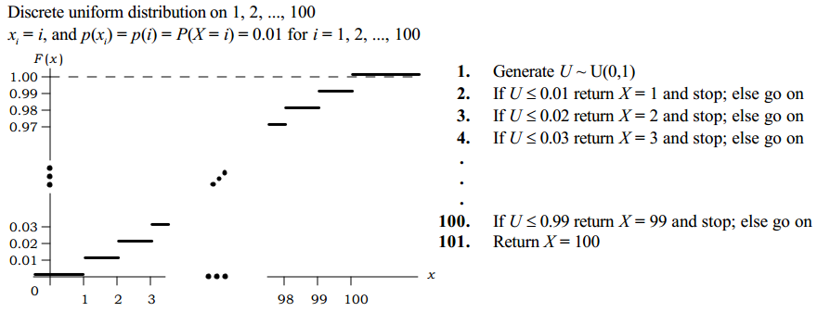
Inverse Transform (Discrete)

Slide 42
Inverse Transform Method
Limitations
Must invert CDF, which may be difficult (numerical methods)
May not be the fastest or simplest approach for a given distribution
Advantages
Uses only a single U(0,1)
Example / Try Others
Bernoulli, Poisson, Exponential

Slide 43
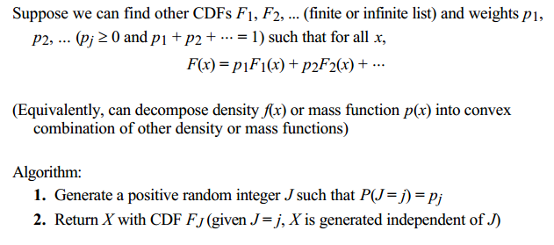
Composition
What if the inverse transform is difficult or slow?

Slide 44
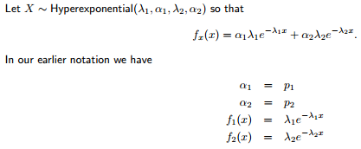
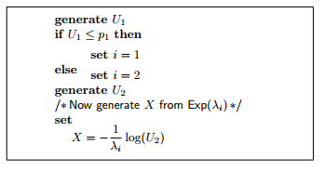
HyperExponential Distribution

Slide 45
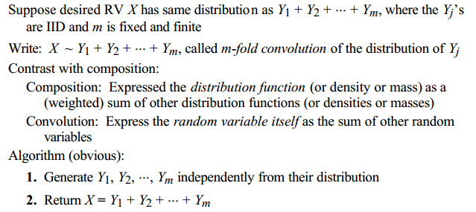
Convolution

Slide 46
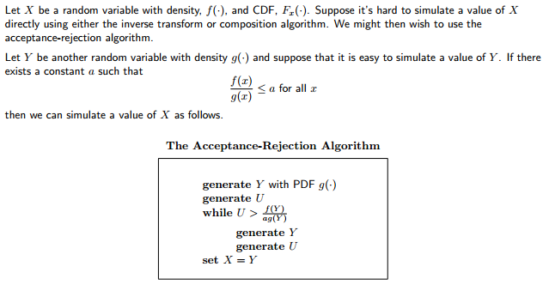
Acceptance-Rejection

Slide 47
Reading
Chapter 7,8
Law Kelton Book

